Slide 1


LESSONS LEARNT
INTERNSHIP PROJECT
BY
AKILESH K
Under the guidance of
Mr. Baranidharan, Asokan

Slide 2
ABOUT ME
Completed my 10th grade in DAV public school , Velachery.
High schooling in Sri Chaitanya institution in Vizag.
Currently pursuing my BTECH in Electronic and Computer engineering at VIT Chennai.
I am a hardworking and ambitious individual with a great passion for Technology.
I have completed numerous projects related to Application development.

Slide 3
INTERSHIP PURPOSE & PROJECT ASSIGNED
Purpose of Internship
To learn and seek mentorship from industrial professional
To make myself industry ready and learn to work in a cooperate Environment
Project Assigned
To create a Web application with proper Database system to enable user to provide the lesson learnt in each project and to assign these appropriate lesson learnt to people in new projects.

Slide 4
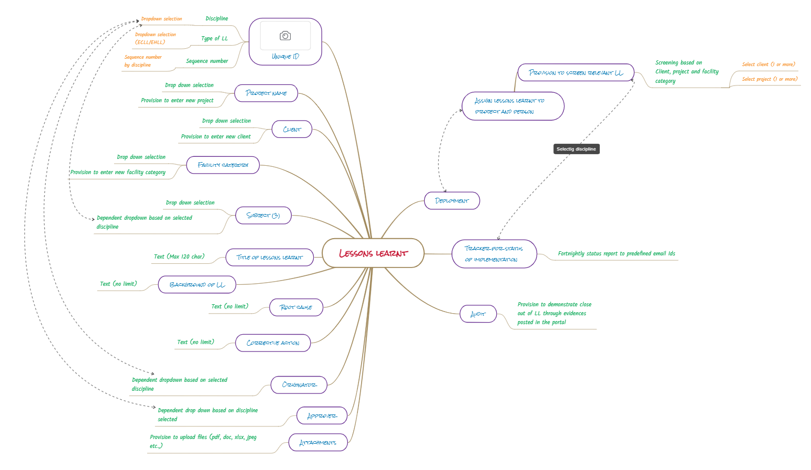
UNDERSTANDING OF INTERSHIP PROJECT

Slide 5
EXPECTATION
Stores data in one central location.
Allows data to be shared by many users.
Provides user interfaces to work with the data.
Controls who can access and edit the data.

Slide 6
PROJECT EXECUTION
CSS HTML is the front end code used to develop the application. CSS is the language we use to style an HTML document.CSS describes how HTML elements should be displayed.
PHP is a widely used server-side programming language. PHP works well with HTML and databases, making it a great language for building dynamic web applications.
XAMPP was for database management and visual studio code for coding and development

Slide 7

CONCLUSION
Thus ,by using these tools, I created a robust website for managing lessons learnt.
Created a proper database structure for administration with a clean frontend design to support the user
Thus ,was able to create a web application from scratch.

Slide 8
NEXT STEP
Have to perform high volume testing and bug correction.
Make required modification to suit the organization

Slide 9
THANK YOU

